Slide 1
SQL Server Architecture
Module 2

Slide 3
Learning Units covered in this Module
Lesson 1: Introduction to SQL Operating System
Lesson 2: SQL Server Waits and Queues
Lesson 3: SQL Server Disk I/O

Slide 4
Lesson 1: Introduction to SQL Operating System

Slide 5

Objectives
After completing this learning, you will be able to:
Understand Microsoft SQL Server Architecture Overview.
Learn SQL Server Operating System (SQLOS) Components.

Slide 6
Inside the Database Engine
Protocols
Shared Memory / TCP / Named Pipes
Relational Engine
Storage Engine
Parser and Algebrizer
Query Optimizer
Access Methods
Pages
Records
Indexes
LOB
Versioning
Allocation
Utilities DBCC
Bulk Load
Backup
Restore
Buffer Manager
Database Engine
File Manager
Query Compiler
Query Executor
Transaction Services
SQLOS API
Monitoring
Synchronization
Deadlock Monitor
Lazy
Writer
XEvents
Lock Manager
Thread Scheduling
I/O
Resource
Management
Resource Monitor
Scheduler Monitor
Buffer Pool
Memory Manager
Notes:
While all this has been running, several other parts of SQLOS have been active:
Monitoring: DMVs, Extended Events (xEvents), and so on.
Deadlock Monitor thread: Monitors for and deals with deadlocks.
Lazy Writer threads: Clock sweeping the buffer pool to maintain the free lists and responsible for writing dirty pages to disk between checkpoints.
Scheduler Monitor thread: Monitors scheduler health and detects issues such as non-yielding scenarios.
Resource Monitor thread: Monitors available memory from operating system and internal to SQL Server and notifies the Clerks.
The Hosting APIs for external components interface with Microsoft Data Access Components (MDAC) and common language runtime (CLR).
The Storage Engine manages all data access, both through transaction-based commands (with the Transaction Manager) and bulk operations such as backup, bulk insert, and certain Database Console Command (DBCC) commands.
Access Methods is an important component of the Storage Engine, and contains components to open a table, retrieve qualified data, and update data.
The Access Methods code does not actually retrieve the pages, it will make a request to the Buffer Manager, which holds a copy of the requested data pages in memory (and if the requested page is not in memory, it will retrieve it from disk). By memory, we mean specifically the Buffer Pool, which is part of the SQLOS.
The Transaction Manager ensures that transactions adhere to the ACID properties: atomicity, consistency, isolation, and durability.
It also outlines the boundaries of statements that must be grouped together to form an operation, and it allows “nested” transactions by managing savepoints, if any. Furthermore, it also coordinates with the Lock Manager regarding when locks can be released, based on the isolation level in effect. It also coordinates with Access Methods to determine when old versions of rows are no longer needed and can be removed from the version store.
The File Manager handles actual physical access to data and log files, as well as access to backup devices.
Also included in the storage engine are components for controlling utilities such as Bulk Load, DBCC commands, and Backup/Restore operations.
The SQLOS layer handles activities that are normally considered to be operating system-like responsibilities, such as Thread Scheduling, Synchronization services (latching and deadlock detection), Memory management (including the Buffer Pool), Lock management, I/O management (which establish the completion routines for read/write operations from memory to disk and vice-versa) , and Monitoring (such as DMVs and xEvents).
Locking is a crucial function of a multi-user Remote Desktop Management Services (RDMS) such as SQL Server, even if you are operating an optimistic concurrency model such as snapshot isolation level, to help ensure the isolation and consistency properties of ACID. This is handled by the Lock Manager, whose main job is to provide hierarchical access to data in a concurrent fashion (as allowed by the Isolation Level of the transaction), by managing compatibility between the lock types. It also resolves deadlocks (with the aid of the Deadlock Monitor thread), and escalates locks if needed. Other components such as the other threads in the figure will be explained in an upcoming lesson in this module.

Slide 7
Two Main Functions of SQLOS
Management
Memory Manager
Monitoring
Resource Monitor
Process Scheduler
Synchronization
I/O
Support for Non-Uniform Memory Access (NUMA) and Resource Governor
Deadlock Monitor
Scheduler Monitor
Lazy Writer (Buffer Pool management)
Dynamic Management Views (DMVs)
Extended Events
Dedicated Administrator Connection (DAC)
Notes:
Key Points:
The two core responsibilities of the SQLOS are Resource Management and Monitoring. All the information used to manage and monitor resources within the SQL Server process space is exposed to the DBA via Dynamic Management Views (DMVs). These views expose the memory structures used within the SQLOS to account for all the resources in use, thus giving the DBA complete knowledge of the state of the SQL Server process.

Slide 8
Dynamic Management Views and Functions
Category | Description
sys.dm_exec_% | Execution and connection information
sys.dm_os_% | Operating system related information
sys.dm_tran_% | Transaction management information
sys.dm_io_% | I/O related information
sys.dm_db_% | Database information
Notes:
Dynamic management views and functions return server state information that can be used to monitor the health of a server instance, diagnose problems, and tune performance.
Querying Dynamic Management Views
Dynamic management views can be referenced in Transact-SQL statements by using two-part, three-part, or four-part names. Dynamic management functions on the other hand can be referenced in Transact-SQL statements by using either two-part or three-part names. Dynamic management views and functions cannot be referenced in Transact-SQL statements by using one-part names.
All dynamic management views and functions exist in the sys schema and follow this naming convention dm_*. When you use a dynamic management view or function, you must prefix the name of the view or function by using the sys schema. For example, to query the dm_os_wait_stats dynamic management view, run the following query:
SELECT wait_type, wait_time_ms
FROM sys.dm_os_wait_stats;

Slide 9
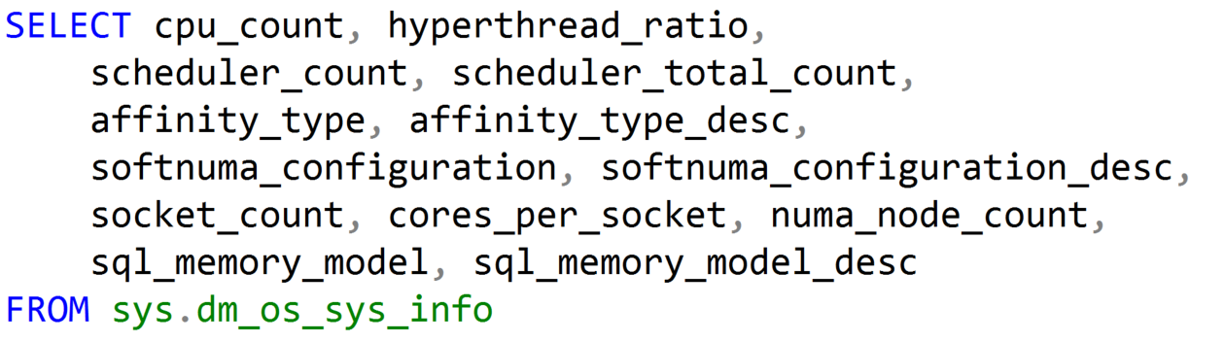
Using Dynamic Management Objects (DMOs)
Must reference using the sys schema
Two basic types:
Real-time state information
Historical information
Notes:
Two basic types:
Real-time state information
Historical information
The DMVs that end with the word “stats” will display historical information.
The DMVs that do not end with the word “stats” will display current activity.
To return useful information about the computer, and about the resources available to and consumed by SQL Server use the sys.dm_os_sys_info
view. (https://docs.microsoft.com/en-us/sql/relational-databases/system-dynamic-management-views/sys-dm-os-sys-info-transact-sql)

Slide 10
SQL Server Configuration
Processor Configuration Settings And Best Practices
Affinity Mask
Assigns CPUs for SQL Server use
Set via sp_configure or Alter Server Configuration
Cost Threshold for Parallelism
Only queries with a cost that is higher than this value will be considered for parallelism
Max Worker Threads
Number of threads SQL Server can allocate
Recommended value is 0. SQL Server will dynamically set the Max based on CPUs and CPU architecture
Only required in specific scenarios
Only required when dealing with excessive parallelism
Max Degree of Parallelism (MAXDOP)
Maximum number of processors that are used for the execution of a query in a parallel plan. This option determines the number of threads that are used for the query plan operators that perform the work in parallel.
Notes:
Affinity Mask
The affinity mask settings on most servers will be set to 0, which allowed SQL Server to use all available CPUs on the server as and when needed. In some scenarios where you may not be running a dedicated server, you may want to split workloads to different sets of CPUs. For instance, if you have two SQL Server instances on a single machine, you may benefit from more predictable performance if each instance ran on its own subset of CPUs. As with all these configurations, a good test plan is necessary to know what is best for your environment.
References:
affinity mask Server Configuration Option - https://docs.microsoft.com/en-us/sql/database-engine/configure-windows/affinity-mask-server-configuration-option?view=sql-server-ver15
Cost Threshold for Parallelism
SQL Server uses the cost threshold for parallelism as the minimum cost to consider parallel plans. SQL Server tries to assign a cost value to each query plan as it tries to find the best plan for a given query. If the cost is below the Cost Threshold for Parallelism, parallel plans will not be looked at. Adjusting this threshold could result in more or less parallel plans and this can have a significant impact on performance. Generally, leaving this as the default is recommended, unless you have noticed an issue with the number of parallel plans being used by SQL Server for your workload.
References:
Configure the cost threshold for parallelism Server Configuration Option - https://docs.microsoft.com/en-us/sql/database-engine/configure-windows/configure-the-cost-threshold-for-parallelism-server-configuration-option?view=sql-server-ver15
Max Worker Threads
This determines the number of worker threads SQL Server can use. By default, it is set to 0, meaning that SQL Server will decide the best number based on the number of CPUs on the server and the CPU architecture. As with most settings, this should rarely, if ever, be changed.
References:
Configure the max worker threads Server Configuration Option - https://docs.microsoft.com/en-us/sql/database-engine/configure-windows/configure-the-max-worker-threads-server-configuration-option?view=sql-server-ver15
How to determine proper SQL Server configuration settings - https://support.microsoft.com/en-us/help/319942/how-to-determine-proper-sql-server-configuration-settings

Slide 11

Demonstration
Dynamic Management Views
Notes:
M01L01Demo01
“Use Overview of DMVs.sql”
Key here is to understand why are the DMVs useful. You will be able to determine factors such as:
Need to add more CPUs
Need to add more memory
Running under memory pressure
Have problems with disks
Move to a 64-bit based solution
Need to change your application for query correctness reasons
What applications are loaded into the SQL Server address space
If SQL Server is paged out and if it affects performance of your application
If your hardware is NUMA
The list goes on…

Slide 12

Questions?

Slide 13
Lesson 2: Waits and Queues

Slide 14
Objectives
After completing this learning, you will be able to:
Understand SQL Server task scheduling.
Understand Waits and Queues

Slide 15
Microsoft SQL Server Scheduling Terminology
Batch
A statement or set of statements submitted to SQL Server by the user (a query), also referred to as a request
Monitor with sys.dm_exec_requests
Task
A batch will have one or more tasks (aligns with statements)
Monitor with sys.dm_os_tasks
Worker Thread
Each task will be assigned to a single worker thread for the life of the task
Monitor with sys.dm_os_workers
Notes:
SQL Server Scheduling Terminology
A batch is a query or a set of queries being executed as a whole, it is basically everything between the GO separator as the GO command is a batch terminator.
The GO terminator determines what is going to be sent to SQL Server to be executed. A batch is a single unit of code that is sent to SQL Server, it can be one query or many queries. Internally, a batch from the client to the SQL Server is seen as a request, a request for work to be done.
All of the active requests can be seen in sys.dm_exec_requests. If your query is completed and your session is still open and idle it is not going to show up in sys.dm_exec_requests. It is only something that is actively executing a command or a request.
A task is a unit of work that is scheduled by SQL Server. A request or a batch will have one or more tasks. A very simple query will have one task, but a more complicated query such as one that runs in parallel will have multiple tasks. If you have a large query that runs in parallel and it is broken into separate parts then that query is going to have multiple tasks. You can monitor with sys.dm_os_tasks.
A worker thread is a thread that is assigned to a task to do the work the task requires. This is a logical thread in the SQL Server process. The SQL Server process will have many worker threads. The number of worker threads we have is dynamic. SQL Server will spin up additional threads based on what the current workload is. After the task is complete, the worker thread that was assigned goes back into the pool and will be assigned to another thread when needed from the pool. This can be monitored with sys.dm_os_workers.
These worker threads are being used to send work out to Windows for the CPUs to be executed. So the worker threads in SQL Server will map to an operating system-level thread which is where the work is actually being done. We are managing these threads internally with an internal scheduler but we are also farming them out to the Windows OS to be executed on the CPU so they end up going through the Windows scheduler as well.
Key Points:
Queries are submitted to SQL Server in the form of a batch which may contain one or many statements. Each statement within a batch is executed individually in succession and the results are sent to the client when complete. Typically a batch will result in a single task being executed, but queries that have parallel execution plans will have several tasks that are executed simultaneously (typically resulting in faster execution).
When a task is scheduled, it is assigned to a worker thread. When it is time for the task to do work on a CPU, the SQL Server worker thread is submitted to the operating system for processing and will be assigned to an operating system thread. After the thread is submitted to the operating system for execution, Windows takes over and handles scheduling the thread for execution on one of the system CPUs.
The default maximum number of worker threads can be calculated using the following formula:
Maximum worker threads = (512+ (<# of processors> -4) * 16)
Additional Reading:
SQL Server Batch or Task Scheduling
http://msdn.microsoft.com/en-us/library/ms189267.aspx
Thread and Task Architecture
http://msdn.microsoft.com/en-us/library/ms176043.aspx
Configure the max worker threads Server Configuration Option
http://msdn.microsoft.com/en-us/library/ms190219.aspx
Although the term 'execute' is used commonly in jargon, such as in 'execute a query', it should be avoided whenever possible in Microsoft content because of its violent and militaristic connotations. Do not use 'execute' in content for home users or information workers. Use 'run' instead. If the user interface includes 'execute', the user or program action is still run. Always use 'run' in the context of macros and queries. 'Execute' is acceptable in content for software developers because it has become ingrained, especially in the passive voice. 'Run' is preferable, however, where it does not cause any loss of meaning.
Please check all instances in the document.
I changed this to remove bold and underline as it is against Microsoft style purely for emphasis. Please remove such formatting throughout
Please avoid using first person “we”, “I”, or “our”. Always use “you” or “Microsoft” if that is applicable.

Slide 16
Hierarchy of Common Terms
SELECT *
FROM sys.dm_exec_connections;
-- relevant data:
-- session_id --> spid
-- most_recent_sql_handle --> last query
-- net_transport, protocol_type --> connectivity
SELECT *
FROM sys.dm_exec_sessions;
-- relevant data:
-- session_id --> spid
-- host_name, program_name --> client identity
-- login_name, nt_user_name --> login identity
-- status --> activity
-- database_id --> database being accessed
-- open_transaction_count --> blocking identification
SELECT *
FROM sys.dm_exec_requests;
-- relevant data:
-- session_id --> spid
-- status --> background, running, runnable, suspended
-- sql_handle, offset --> query text
-- database_id --> database being accessed
-- wait_type, wait_time --> blocking information
-- open_transaction_count --> blocking others
-- cpu_time, total_elapsed_time, reads, writes --> telemetry
SELECT *
FROM sys.dm_os_workers;
-- relevant data:
-- worker_address --> memory address of the worker
-- wait_start_ms_ticks --> Point in time worker Suspended.
-- wait_resumed_ms_ticks --> Worker in Runnable state.
-- state -- > Running, Runnable, Susspended
SELECT *
FROM sys.dm_os_tasks;
-- relevant data:
-- task_state --> running, suspended
-- pending_io_* --> I/O activity
-- scheduler_id -->processor info
-- session_id --> spid
Connection
Session
Request (Batch)
Task
Worker
Notes:
* Can suffer from waits until completion.
Key Points:
A client opens a connection, and after login, a connection opens a session. In a session, a query represents a request. The requests are handed over to tasks that see the work being done, that get one or more workers (threads) assigned to carry on the work until completion.
Queries are submitted to SQL Server in the form of a batch, which may contain one or many statements. Each statement within a batch is executed individually in succession and the results are sent to the client when complete. Typically, a batch will result in a single task being executed, but queries that have parallel execution plans will have several tasks that are executed simultaneously (typically resulting in faster execution).
When a task is scheduled, it is assigned to a worker thread. When it is time for the task to do work on a CPU, the SQL Server worker thread is submitted to the operating system for processing and will be assigned to an operating system thread. After the thread is submitted to the operating system for execution, Windows takes over and handles scheduling the thread for execution on one of the system CPUs.
Calculated Worker Threads at Startup:
Number of CPUs 32-bit computer 64-bit computer
<= 4 processors 256 512
8 processors 288 576
16 processors 352 704
32 processors 480 960
Caution: We recommend 1,024 as the maximum for 32-bit SQL Server.
Additional Reading:
SQL Server Batch or Task Scheduling (http://msdn.microsoft.com/en-us/library/ms189267.aspx)
Thread and Task Architecture (http://msdn.microsoft.com/en-us/library/ms176043.aspx)
Configure the max worker threads Server Configuration Option (http://msdn.microsoft.com/en-us/library/ms190219.aspx)
How To Diagnose and Correct Errors 17883, 17884, 17887, and 17888 (http://technet.microsoft.com/en-us/library/cc917684.aspx#XSLTsection129121120120)
IS suffer the correct word to use in this context or can this be reworded?
Added a comma to improve readability. Please check for accuracy.

Slide 17
Scheduling Types
Non-Preemptive (Cooperative)
SQL Server manages CPU scheduling for most activity (instead of the operating system).
SQL Server decides when a thread should wait or get switched out (known as yielding).
Preemptive
Preemption is the act of an operating system temporarily interrupting an executing task.
Higher priority tasks can preempt lower priority tasks.
SQL Server developers also programmed some predetermined voluntary yields to avoid starvation of other threads
Preemptive mode used in SQL Server for external code calls, CLR with an UNSAFE assemblies, extended stored procedures
Notes:
Key Points:
Preemptive mode means non–cooperative. If a scheduler quantum time allocated to a particular thread is exceeded or if a high-priority task needs to be executed, then the operating system will interrupt the previous processes and run the high-priority task by maintaining a queue of suspended or runnable tasks. This is also the running mode of some low-level SQLOS actions, such as doing physical I/O, or running external code such as extended stored procedures.
Preemptive mode used in SQL Server for external code calls, CLR with an UNSAFE assemblies, APIs that could block for extended periods (example –extended stored procedures).
Non-preemptive mode means it is cooperative. The underlying operating system will not interrupt the currently running process, and instead SQL Server manages all thread priorities, voluntarily yielding when necessary.
SQL Server developers also programmed some predetermined voluntary yields to avoid starvation of other threads
Additional Reading:
How To Diagnose and Correct Errors 17883, 17884, 17887, and 17888 (https://technet.microsoft.com/en-us/library/cc917684.aspx#XSLTsection129121120120)

Slide 18
SQL Server Task Scheduling
One SQLOS Scheduler per core/logical processor
Handles scheduling tasks, I/O, and synchronization of resources
Work requests are balanced across schedulers based on the number of active tasks
Monitor using sys.dm_os_schedulers
Notes:
SQL Server Task Scheduling
To manage those tasks, we have schedulers within the SQLOS. We have one scheduler per core or logical processor, what that means is if I have one quad core processor in my server internally, I have four user mode schedulers. These are schedulers that are used to execute user tasks. If the system is hyperthreaded, it will increase the number of user mode schedulers. SQL Server sees it as an additional logical CPU.
SQL Server Task Scheduling handles scheduling tasks, I/O, and synchronization of other resources that tasks require during the scope of execution.
Work requests are balanced across schedulers based on the number of active tasks. So, when a new task comes into SQL Server, it will be assigned to the scheduler that has the fewest number of active tasks. You may find that you have idle tasks laying around that are assigned to schedulers. Those are not considered when we are doing this load balancing. This is a real active task count so we have an even balance across the CPUs.
SQL Server Task Scheduling can be monitored by using sys.dm_os_schedulers.
To give perspective on where the scheduler thing comes from, back in the day when we had SQL Server 6.5, we relied almost entirely on the Windows operating system to schedule work for us. We eventually ran into bottlenecks because of this and we would see that the CPUs were tasked to do too much work, which resulted in the phenomenon called context switching. Context switching essentially means that the CPU is spending too much time switching between tasks and is not really doing anything useful.
In SQL Server 2000, we introduced the UMS (User Mode Scheduler), which was an early version of the SQLOS. The UMS had the main purpose of trying to make sure that we had only so many active tasks as can be handled by the CPUs. We found that performance was improved in doing this on multi-processor machines. This also maintained some additional context. We maintained context inside the SQL Server scheduler so those context switches do not have as dramatic of an effect.
The key point is that the operating system is a preemptive scheduler at its level and could switch SQL Server threads out. We try to prevent that by yielding the CPU. This means that when a task completes to a certain extent, it will yield the CPU and give way to whatever else that could be scheduled on the same CPU.
We have come a long way since the early days of scheduling, we do still rely on the operating system for some low-level scheduling, but SQL Server does its own yielding to make sure tasks get the time they need and we avoid CPU bottlenecks.
Key Points:
SQL Server will create one internal scheduler for each CPU (core or logical processor) that is detected. Work requests that need to be performed by SQL Server will be load-balanced across all the schedulers based on an internal calculation called load factor. When a task is enqueued on a scheduler, the load factor is increased. When a task is completed, the load factor is decreased. In this way, SQL Server can help ensure a balanced workload across all the CPUs.
While there is one scheduler per CPU, a scheduler is not necessarily bound to a particular CPU. After the thread has been handed off to the operating system by the scheduler, it will enter the operating system processor queue like any other process. The default behavior is to use all available CPUs and allow the operating system to balance the threads accordingly, but this can be changed by adjusting the processor affinity through the PROCESS AFFINITY server configuration.
Additional Reading:
ALTER SERVER CONFIGURATION (Transact-SQL)
http://msdn.microsoft.com/en-us/library/ee210585.aspx
affinity mask Server Configuration Option
http://msdn.microsoft.com/en-us/library/ms187104.aspx
SQL Server 2016 Scheduler Changes
https://docs.microsoft.com/en-us/archive/blogs/bobsql/sql-2016-it-just-runs-faster-updated-scheduling-algorithms
https://techcommunity.microsoft.com/t5/sql-server/sql-server-2019-intelligent-performance-worker-migration/ba-p/939610
Worker migration allows an idle scheduler to migrate a worker from the runnable queue of another scheduler on the same NUMA node and immediately resume the task of the migrated worker. This enhancement provides more balanced CPU usage in situations where long-running tasks happen to be assigned to the same scheduler.
Please avoid using first person “we”, “I”, or “our”. Always use “you” or “Microsoft” if that is applicable. Please check for this globally.
Change to perform
This entire section has a very conversational tone, which is not the norm for Microsoft courseware. Please revisit the notes section to see if the informal tone can be reduced.
UMS is not listed as an approved acronym in Term Studio. Please check if you still want to sue it and if the target audience would understand it.
Consider changing to “The main purpose of UMS was to make sure that the number of active tasks was limited to what can be handled by the CPUs.”

Slide 19
Waits and Queues
Troubleshooting methodology to identify resource bottlenecks.
SQL Server maintains the state in which workers wait.
Waits are represented by the SQL Server wait statistics; tracking waits over time.
Queues are represented by performance objects and counters.
Notes:
Key Points:
SQL Server has to handle a large number of requests with limited resources. Therefore, waiting and queuing is how SQL Server handles the requests.
Waits and Queues is a methodology of tuning by focusing on where SQL Server is spending most of its time waiting. Analyzing a task as it moves through the various queues in the scheduler reveals a lot about where it is spending its time.
As an application, SQL Server may request system resources as it executes a user query and waits for its request to be completed. Waits are represented by SQL Server wait statistics. Since SQL Server 2005, SQL Server tracks wait information any time that a user connection or session_id is waiting. This wait information is summarized and categorized across all connections so that a performance profile can be obtained for a given work load. Therefore, SQL Server wait types identify and categorize user (or thread) waits from an application workload or user perspective.
Queues measure system resources and utilization. The queues part of performance is represented by Performance Monitor objects and counters and other sources of information. Performance Monitor counters measure various aspects of performance such as transfer rates for disks or the processor time consumed. SQL Server object counters are exposed to Performance Monitor using the dynamic management view (DMV) sys.dm_os_performance_counters. Thus, Performance Monitor counters show performance from a resource point of view.
Additional Reading:
SQL Server Performance Tuning – Waits and Queues (http://technet.microsoft.com/en-us/library/cc966413.aspx)
SQL Server Performance Tuning Using Wait Statistics: A Beginner’s Guide (https://www.sqlskills.com/help/sql-server-performance-tuning-using-wait-statistics)

Slide 20
Thread States and Queues
Runnable: The thread is currently in the Runnable Queue waiting to execute. (First In, First Out).
Running: One active thread executing on a processor.
Suspended: Placed on a Waiter List waiting for a resource other than a processor. (No specific order).
Notes:
10987B
1: SQL Server Architecture, Scheduling, and Waits

Slide 21
Yielding
In SQL Server, each thread is assigned a quantum (duration 4ms), with SQL Server using a cooperative model to ensure its CPU resources are shared amongst all the threads that are in a runnable state, preventing the ‘starving’ condition of any individual thread.
By design, a worker owns the scheduler until it yields to another worker on the same scheduler.
When no worker is currently on the Runnable list, the yielding worker is allowed another quantum or performs the necessary idle scheduler maintenance.
Notes:
Additional Reading:
How To Diagnose and Correct Errors 17883, 17884, 17887, and 17888 (http://technet.microsoft.com/en-us/library/cc917684.aspx#XSLTsection129121120120)
One cause of time-outs

Slide 22
Yielding
Runnable List
Status: runnable
CPU available
Start
CPU
Status: running
Complete
Quantum exhausted
End
Resource blocked
Waiter List
Status: suspended
Resource available

Slide 23
Task Execution Model
Status: Running
session_id 60
Running
Wait Queue (Resource Waits)
Status: Suspended
session_id 51
session_id 60
Runnable
session_id 51
IO_Completion
session_id 51
Runnable
Running
FIFO List
session_id 73
LCK_M_S
session_id 59
NETWORKIO
session_id 56
CXPACKET
Runnable Queue (Signal Waits)
Status: Runnable
session_id 56
Runnable
session_id 55
RESOURCE_SEMAPHORE
SPID56 moved to the bottom of the Runnable queue.
session_id 51
Runnable
SPID60 moved to the Waiter List.
SPID51 moves from Runnable queue with a Runnable status to Running status.
SPID60 needs a page not in cache. Thus its status changes from Running to Suspended with wait type IO_Completion.
SPID64 then moves to the top of the Runnable queue.
SPID56 is waiting for a parallel process to complete. When the parallel process is completed, the status for SPID56 changes from Suspended with wait type CXPACKET to Runnable.
session_id 60
IO_Completion
session_id 64
Runnable
Unordered List
session_id 87
Runnable
session_id 52
Runnable
session_id 56
session_id 93
session_id 56
Runnable
Runnable
Runnable
23
Notes:
Example: Two Logical Processors
Key Points:
SQL Server will create a scheduler for each logical CPU that is available on the system. Each one of these schedulers is responsible for managing the active tasks that are assigned to it and ensuring that one thread is always in the Running position, that is, it is being submitted to the operating system for execution on a CPU.
Because each scheduler represents one CPU, there can only be one task in the Running position at any given time. The other tasks will be in either the Runnable Queue (with a status of Runnable) or the Wait Queue (with a status of Suspended). Tasks in the Runnable Queue are experiencing Signal Waits. They are ready to be sent out to the CPU for execution, but are waiting for the Running position to be available. Tasks in the Wait Queue are waiting for some resource other than CPU. When a task is in the Wait Queue, it will have a Wait Type and a Wait Resource that indicate what it is waiting for.
Additional Reading:
SQL Server Performance Tuning – Waits and Queues (http://technet.microsoft.com/en-us/library/cc966413.aspx)
sys.dm_os_wait_stats (https://msdn.microsoft.com/en-us/library/ms179984.aspx)
GLOBAL: Do not capitalize generic terms. Please note that we do not capitalize terms unless they are from the UI or are feature or product names. Please consider lowercasing such terms throughout this document.

Slide 24
Task Execution Model
The full cycle between the several task states, for how many times it needs to cycle, is what we experience as the total query response time.
CPU Time (RUNNING)
Total Query Response Time
Signal Wait Time (RUNNABLE)
Resource Wait Time (SUSPENDED)

Slide 25
Relevant Dynamic Management Views (DMVs)
sys.dm_os_wait_stats
Returns information about all the waits encountered by threads that ran.
sys.dm_os_waiting_tasks
Returns information about the wait queue of tasks actively waiting on some resource.
Includes wait type, number of tasks that waited in the specific wait type, total and max wait times, and the amount of signal waits.
sys.dm_exec_requests
Returns information about each request that is in-flight.
Includes session owning the request and status of the request, which will reflect the status of one or more tasks assigned to the request.
Notes:
Additional Reading:
sys.dm_os_wait_stats - Main source of information on waits
(https://msdn.microsoft.com/en-us/library/ms179984.aspx)
sys.dm_os_waiting_tasks - Includes session owning the task, the wait duration and type, information about blocking and the resource that is currently preventing the task from becoming runnable
(https://msdn.microsoft.com/en-us/library/ms188743.aspx)
sys.dm_exec_requests
(https://msdn.microsoft.com/library/ms177648.aspx)
See all waits here: http://blogs.msdn.com/b/psssql/archive/2009/11/03/the-sql-server-wait-type-repository.aspx and http://msdn.microsoft.com/en-us/library/ms179984.aspx

Slide 26
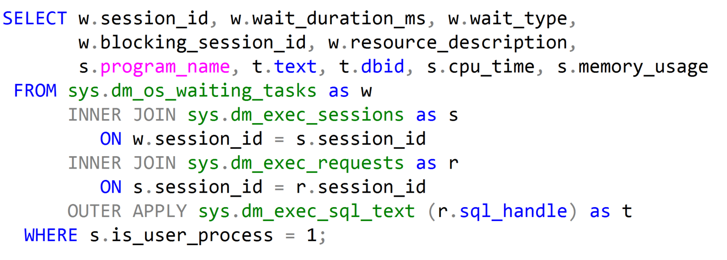
Waiting Tasks DMV
Notes:
Key Points:
Use sys.dm_os_waiting_tasks to show the waiter list at the current moment. sys.dm_exec_requests contains all requests (running, runnable, waiting) that are in-flight, and joining both these DMVs allows us to find what is causing blocking at a given point in time.
Additional Reading:
SQL Swiss Army Knife #11.1 - Locking, blocking and active transactions (http://blogs.msdn.com/b/blogdoezequiel/archive/2012/09/18/sql-swiss-army-knife-11-1-locking-blocking-and-active-transactions.aspx)
Key Points:
The overwhelming majority of scenarios we focus our attention on Resource waits, which may indicate bottlenecks that we have to deal with.
SQL Server bottlenecks may present themselves in different ways:
We might face CPU contention with high CPU consumption and this will have an effect on waits.
Or we might face a situation where available memory is low, also leading to specific wait types.
Disk I/O is also very important, because disk high latencies can slow down any and all operations in SQL Server, and there are specific waits that allow us to scope further actions.
Network I/O should not be overlooked. We might have low bandwidth available, or clients may not be consuming data as fast as SQL Server can provide it – all these have specific cumulative waits in SQL Server.
Then there is transactional locking and blocking, which is paramount for our workload performance, as it represents contention on queries.
The order listed above is not arbitrary. This is the order in which we usually start troubleshooting SQL Server bottlenecks.
Please check if this should be the “waits” list
This sentence reads wrong. Consider changing to “Of all the scenarios that are available, we focus our attention on..”?
Global: Please avoid using first person “we”, “I”, or “our”. Always use “you” or “Microsoft” if that is applicable.

Slide 27
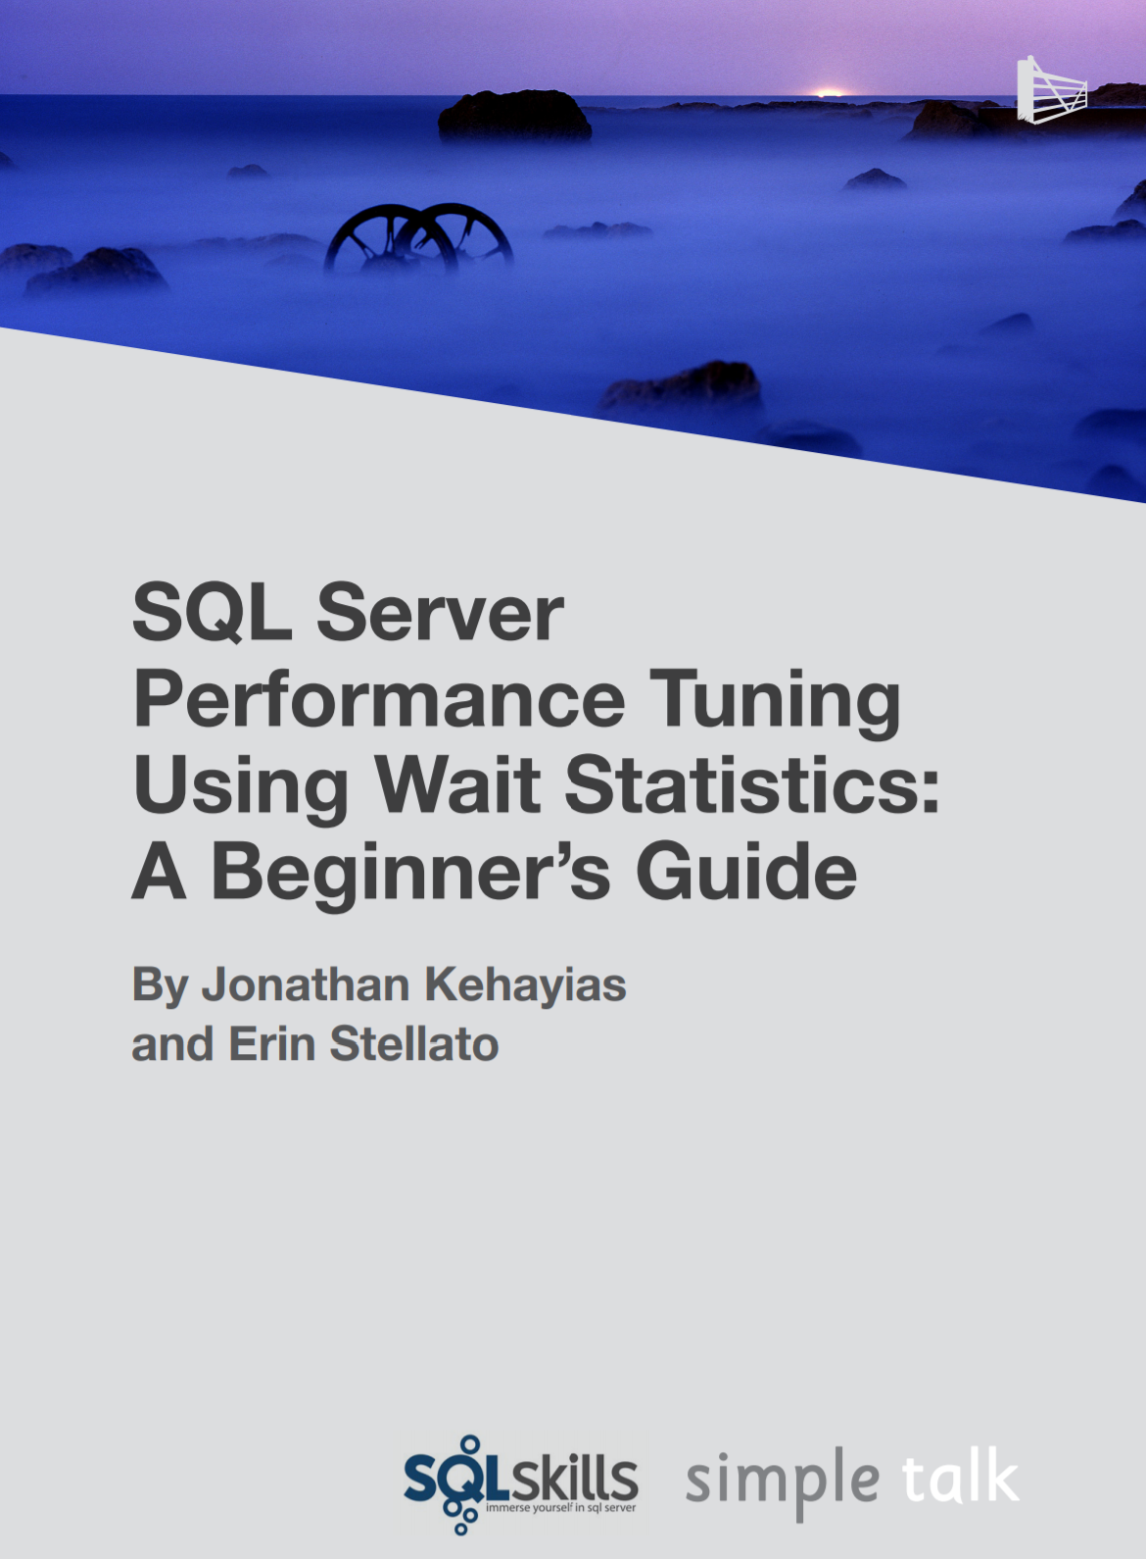
Troubleshooting Wait Types
Aaron Bertrand – Top Wait Types https://sqlperformance.com/2018/10/sql-performance/top-wait-stats
Paul Randal – SQL Skills Wait Types Library https://www.sqlskills.com/help/waits/
Notes:
10987B
1: SQL Server Architecture, Scheduling, and Waits

Slide 28
Lesson 3: SQL Server Disk I/O

Slide 29
SQL Server disk I/O patterns:
Data Files
May have one or more .ndf file
Random reads and writes
Write activity during checkpoints, recovery, and lazy writes
One .mdf file per database
Read activity during backups; other activity varies depending on query activity and buffer pool size
Log Files
One* .ldf file per database
Sequential reads and writes
Write activity during the log buffer flush operations
Read activity during checkpoints, backups, and recovery
Features such as database mirroring and replication will increase read and write activity
Notes:
It is possible to have more than one log file per database, but it is not recommended. As Log files are accessed sequentially (for both read and write operations), multiple log files will not provide any performance benefit.

Slide 30
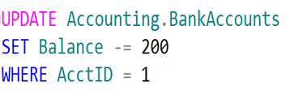

SQL Server Disk I/O (Write-Ahead Logging)
4
LDF
1. Data modification is sent to buffer cache in memory.
1
2
4. Log cache record is flushed to the transaction log
2. Modification is recorded in the log cache.
3
5. At checkpoint, dirty data pages are written to the database file.
Page
3. Data pages are located or read into the buffer cache and then modified.
Page
5
Page
Buffer Cache
MDF or NDF
Notes:
This section describes the role of the write-ahead transaction log in recording data modifications to disk. SQL Server uses a write-ahead logging (WAL) algorithm, which guarantees that no data modifications are written to disk before the associated log record is written to disk. This maintains the ACID properties for a transaction.
To understand how the write-ahead log works, it is important for you to know how modified data is written to disk. SQL Server maintains a buffer cache into which it reads data pages when data must be retrieved. When a page is modified in the buffer cache, it is not immediately written back to disk; instead, the page is marked as dirty. A data page can have more than one logical write made before it is physically written to disk. For each logical write, a transaction log record is inserted in the log cache that records the modification. The log records must be written to disk before the associated dirty page is removed from the buffer cache and written to disk. The checkpoint process periodically scans the buffer cache for buffers with pages from a specified database and writes all dirty pages to disk. Checkpoints save time during a later recovery by creating a point at which all dirty pages are guaranteed to have been written to disk.
Writing a modified data page from the buffer cache to disk is called flushing the page. SQL Server has logic that prevents a dirty page from being flushed before the associated log record is written. Log records are written to disk when the log buffers are flushed. This happens whenever a transaction commits or the log buffers become full.
Key Points:
SQL Server uses the buffer pool to minimize the amount of disk I/O that must be done against the data file. When a page is required for a read or write operation, the buffer pool is checked first. If the page is already in the buffer pool, the operation can be satisfied from memory only.
When a modification happens, the change is made to the data page in memory first, and then a log record is written to the transaction log file. The page will not be written out to disk until the CHECKPOINT process comes through and flushes changes out to the data file. If the SQL Server process is shut down unexpectedly and the memory space is lost, SQL Server uses the transaction log to bring the data file up to date with any changes that were committed before the crash but not persisted to disk. This is called recovery.
To optimize the I/O, SQL Server will attempt to gather pages together so that larger chunks of a file can be read or written in a single operation. For reads, SQL Server has a read ahead mechanism that will read contiguous pages from an object in a single request if needed by a query. For writes, SQL Server will gather together a chunk of contiguous pages that have been modified so they can be written in a single request.
Additional Reading:
SQL Server Transaction Log Architecture and Management Guide
From <https://docs.microsoft.com/en-us/sql/relational-databases/sql-server-transaction-log-architecture-and-management-guide?view=sql-server-ver15>
ACID properties
From <https://docs.microsoft.com/en-us/previous-versions/office/developer/server-technologies/aa480356(v=msdn.10)>
Write-Ahead Transaction Log
From <https://docs.microsoft.com/en-us/sql/relational-databases/sql-server-transaction-log-architecture-and-management-guide?view=sql-server-ver15#WAL>
Writing Pages
From <https://docs.microsoft.com/en-us/sql/relational-databases/writing-pages?view=sql-server-ver15>
Analyzing I/O Characteristics and Sizing Storage Systems for SQL Server Database Applications
From <https://docs.microsoft.com/en-us/previous-versions/sql/sql-server-2008/ee410782(v=sql.100)>

Slide 31
Log Buffer Flushing
SQL Server will flush the log buffer to the log file
SQL Server gets a commit request of a transaction that changes data.
The log buffer fills up. (Max size 60kb.)
SQL Server needs to harden dirty data pages (checkpoints)
Manually request a log buffer flush using the sys.sp_flush_log procedure
Log buffer flushing results in a WRITELOG wait type.

Slide 32
SQL Server Buffer Pool
Stores 8 kilobytes (KB) pages of data to avoid repeated disk I/O.
Pages held in the buffer until the space is needed by something else.
Lazy Writer searches for eligible buffers.
If the buffer is dirty, an asynchronous write (lazy write) is posted so that the buffer can later be freed.
If the buffer is not dirty, it is freed.
Physical
Read
Logical
Read
Buffer Pool
Memory
Disks
Notes:
Key Points:
The buffer pool generally represents the largest percentage of SQL Server memory. In NUMA systems, there will be a separate buffer pool node for each NUMA node.
The buffer pool abstracts the physical location of data and provides caching functions. All data accessed by SQL Server goes through the buffer pool. Therefore, the buffer pool can determine the data that should be stored in the cache to boost performance for frequently used objects.
There are two ways that the data is accessed from the buffer pool:
Logical read. Indicates that the data requested is already present in the cache. A logical read-only involves memory access, so the response time is optimum.
Physical read. Indicates that the data requested is not present in the cache, so the data must be found by using the database files. A physical read is a disk I/O operation, which is more expensive than memory access. When the I/O operation completes, the request is satisfied and the data is stored in the cache so that it can be accessed later.
When a query runs, the database pages that contain the data required to return the query result may or may not be located in physical memory. The query does not have the notion of data locality; it simply requests the page from the buffer pool.
If the pages are in memory, then there is a logical read of the page, which results in a cache hit. If the page is not in memory, then there needs to be a physical read of the page from the disk subsystem. This results in a cache miss event.
Additional Reading:
Buffer Management
https://docs.microsoft.com/en-us/previous-versions/sql/sql-server-2008-r2/aa337525(v=sql.105)
Growing and Shrinking the Buffer Pool Under NUMA
https://docs.microsoft.com/en-us/previous-versions/sql/sql-server-2008-r2/ms345403(v=sql.105)

Slide 33
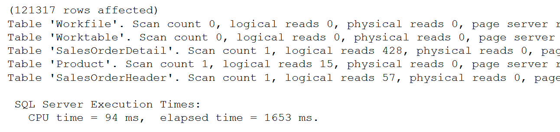
SET STATISTICS IO
SET STATISTICS IO ON
GO
SET STATISTICS TIME ON
SELECT SOH.SalesOrderID, SOH.CustomerID,
OrderQty, UnitPrice, P.Name
FROM Sales.SalesOrderHeader AS SOH
JOIN Sales.SalesOrderDetail AS SOD
ON SOH.SalesOrderID = SOD.SalesOrderID
JOIN Production.Product AS P
ON P.ProductID = SOD.ProductID
SET STATISTICS IO, TIME OFF
Used to identify physical reads and logical reads for a query
Notes:
SET STATISTICS IO (Transact-SQL) - SQL Server | Microsoft Docs
Causes SQL Server to display information about the amount of disk activity generated by Transact-SQL statements.
SET STATISTICS TIME (Transact-SQL) - SQL Server | Microsoft Docs
Displays the number of milliseconds required to parse, compile, and execute each statement.

Slide 34
Total Query Response Time
The full cycle between the several task states, for how many times it needs to cycle, is what we experience as the total query response time.
CPU Time (RUNNING)
Total Query Response Time
Signal Wait Time (RUNNABLE)
Resource Wait Time (SUSPENDED)

Slide 35
Checkpoints
Flushes dirty pages from the buffer pool to the disk. Frequency of checkpoints varies based on the database activity and recovery interval.
Automatic (default) – Database engine issues checkpoints automatically based on the server level “recovery interval” configuration option
Indirect (new in SQL Server 2012) – Database engine issues checkpoints automatically based on the database level TARGET_RECOVERY_TIME
Manual – Issued in the current database for your connection when you execute the T-SQL CHECKPOINT command
Internal – Issued by various server operations
ALTER DATABASE [AdventureWorksPTO] SET TARGET_RECOVERY_TIME = 60 SECONDS
Notes:
Overview
For performance reasons, the Database Engine performs modifications to database pages in memory-in the buffer cache-and does not write these pages to disk after every change. Rather, the Database Engine periodically issues a checkpoint on each database. A checkpoint writes the current in-memory modified pages (known as dirty pages) and transaction log information from memory to disk and, also records the information in the transaction log.
The Database Engine supports several types of checkpoints: automatic, indirect, manual, and internal.
Note
The -k SQL Server advanced setup option enables a database administrator to throttle checkpoint I/O behavior based on the throughput of the I/O subsystem for some types of checkpoints. The -k setup option applies to automatic checkpoints and any otherwise unthrottled manual and internal checkpoints.
For automatic, manual, and internal checkpoints, only modifications made after the latest checkpoint need to be rolled forward during database recovery. This reduces the time required to recover a database.
Important
Long-running, uncommitted transactions increase recovery time for all checkpoint types.
Key Points:
Checkpoints are used by the database engine to minimize the time to recover databases in the event of a server crash or restart. Data page changes are buffered in memory to minimize disk I/O and maximize performance. If the server crashes, any changes made in-memory that have not yet been written to the data file will be lost. Upon restart, SQL Server will need to recover these changes by reading the transaction log file – rolling forward any changes that were committed at the time of the crash and rolling back any changes that were not committed at the time of the crash. This process is called “recovery.”
The “recovery interval” server option allows you to control the estimated time it will take to recover databases on the server upon restart. The default setting is 0, which allows SQL Server to control the interval (typically resulting in checkpoints about every 1 minute and < 1 minute recovery). The longer the recovery interval, the less frequent the checkpoints will be, resulting in less disk I/O on the server. The tradeoff is longer recovery time, thus longer downtime in the event of an unexpected restart. It is recommended to leave the recovery interval at the default, but if there are very frequent changes in a database, particularly changes that always affect the same page in memory, it may be beneficial to increase the interval.
Additional Reading:
Database Checkpoints (SQL Server)
From <https://docs.microsoft.com/en-us/sql/relational-databases/logs/database-checkpoints-sql-server?view=sql-server-ver15>
Configure the recovery interval Server Configuration Option
From <https://docs.microsoft.com/en-us/sql/database-engine/configure-windows/configure-the-recovery-interval-server-configuration-option?view=sql-server-ver15>
Change the Target Recovery Time of a Database (SQL Server)
From <https://docs.microsoft.com/en-us/sql/relational-databases/logs/change-the-target-recovery-time-of-a-database-sql-server?view=sql-server-ver15>

